Slide 1
What feature is the best predictor of a stroke?
Beckett Schultz

Slide 2
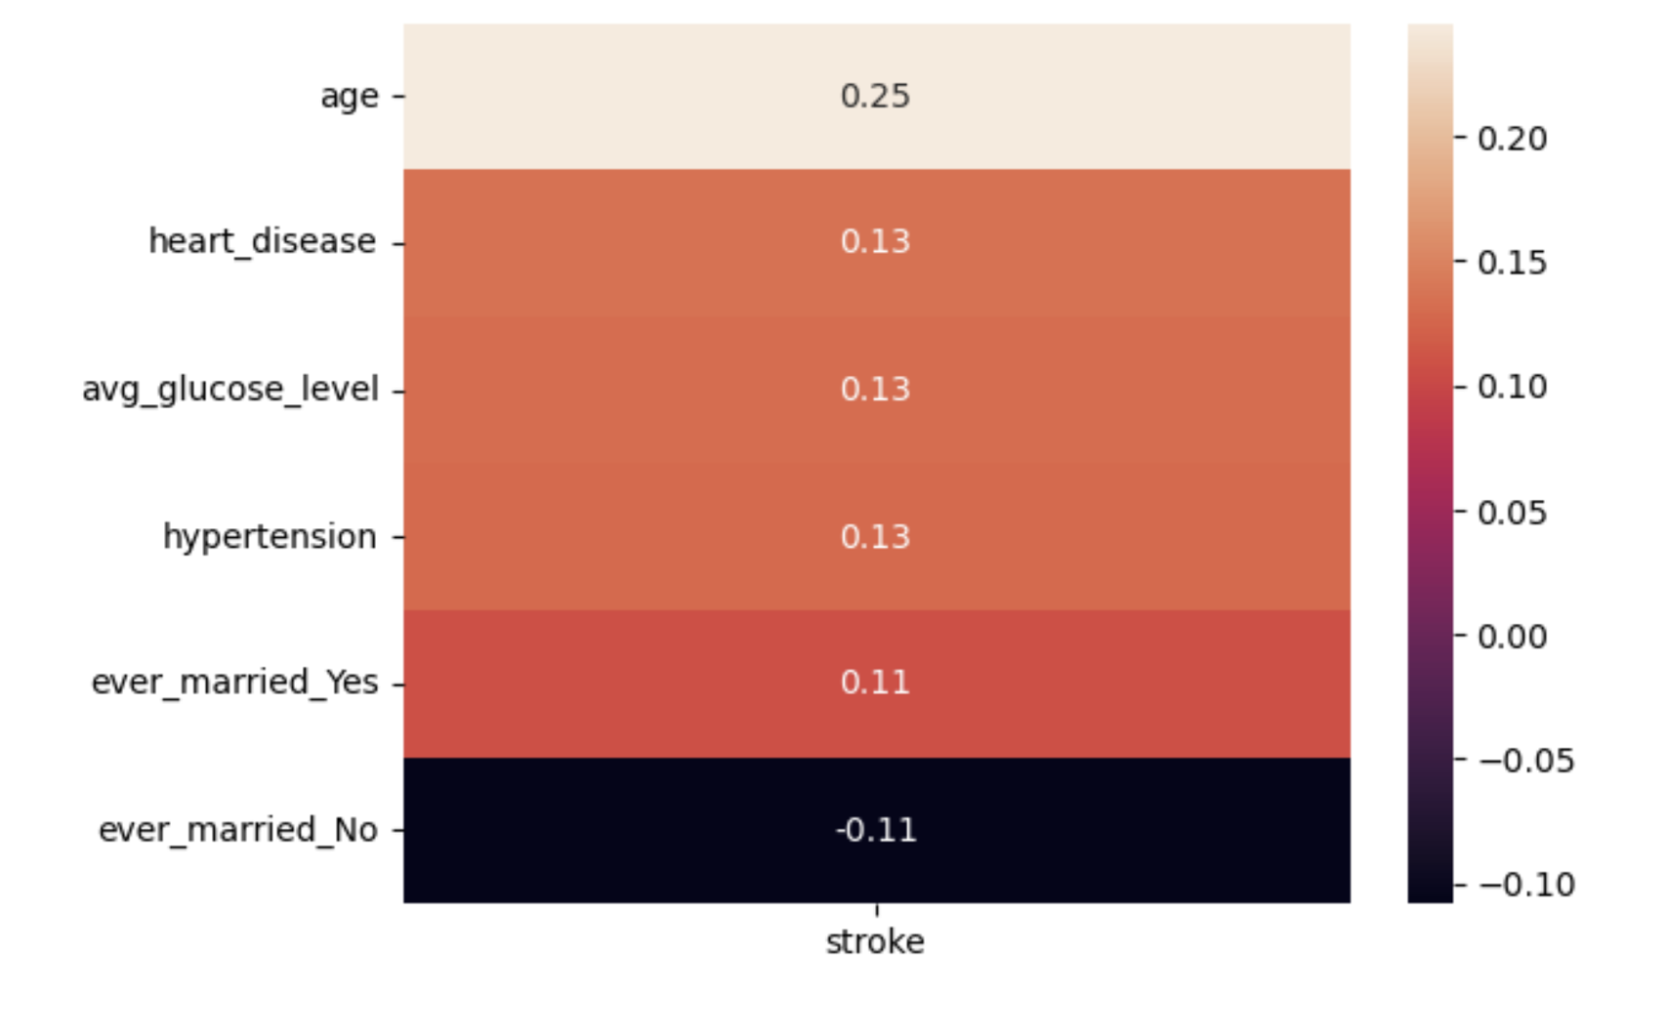
Age is the leading predictor, although not a very strong one.
Histograms with relative and absolute frequencies used
5 leading predictors found from heatmap

Slide 3
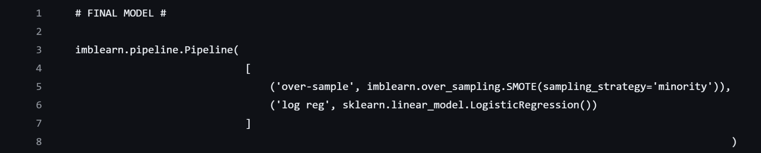
Building predictive model leads to conclusions about data quality.
Model metrics text file containing pipeline with best model
Need better quality data in future

Slide 4
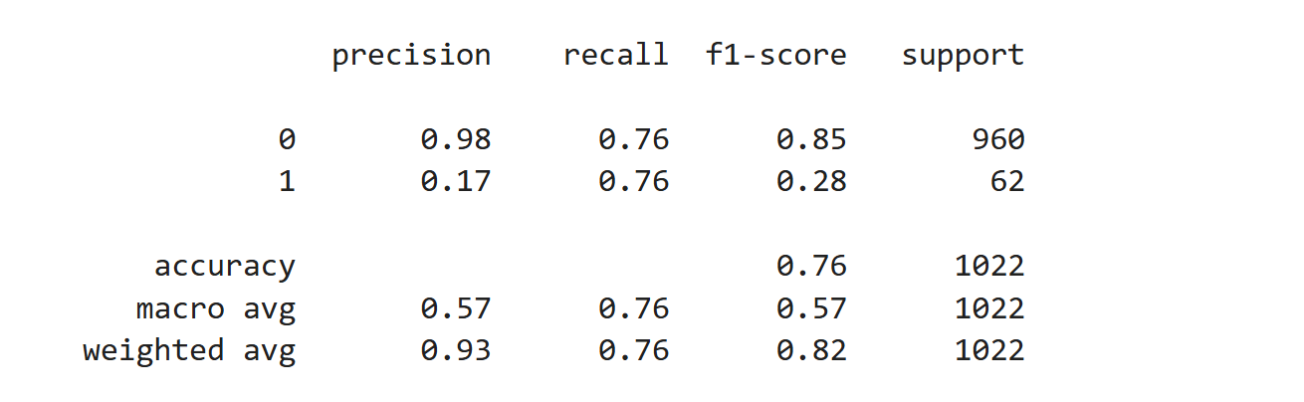
SMOTE object used to perform oversampling fit well into Logistic Regression model.
Synthetic Minority Over-sampling Technique
Used to verify results found in other Logistic Regression model

Slide 5
Logistic Regression model with class_weight argument set to ‘balanced’ performed similarly.
class_weight argument can perform over sampling like SMOTE object
Similar classification report

Slide 6
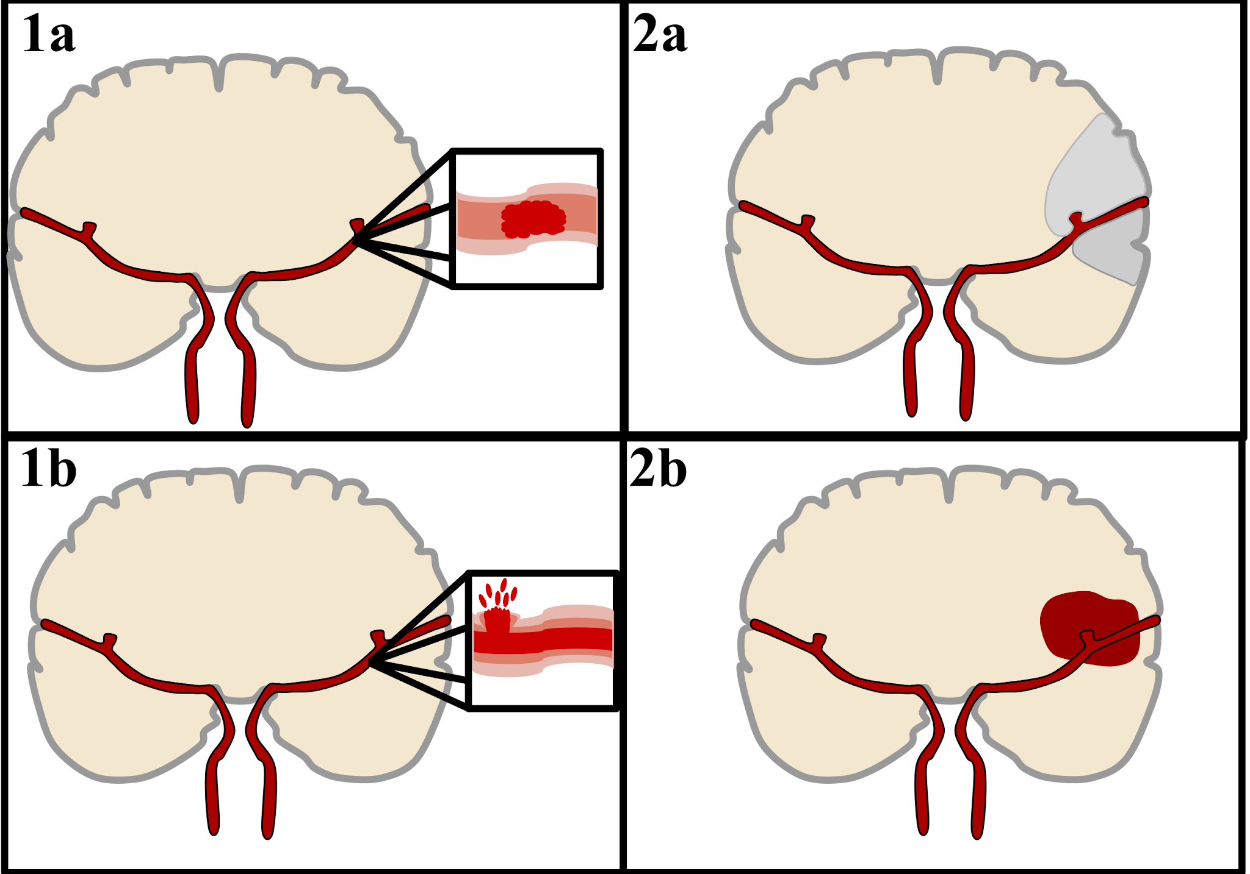
Strokes are very prevalent in today’s world.
2nd leading cause of deaths globally
Account for 11% of total deaths
Sample of patients was collected containing health related characteristics

Slide 7

Data Wrangling was fairly straight forward.
Information gathered from Kaggle
Dataset initially selected because of cleanliness
Missing values imputed with median

Slide 8

Preprocessing was performed to ensure efficiency during model building phase.
Encoded categorical features
Scaled features to have similar mean and variance
80/20 Train Test split used
Stored X and y variables for easier referencing across notebooks

Slide 9

Hyperparameter tuning yielded no improvements.
Performed GridSearchCV, but computationally expensive
Similar results achieved with RandomizedSearchCV through less exhaustive process
PCA used to reduce dimensionality

Slide 10

Other models explored, but results were disappointing.
Decision Tree Classifier
Random Forest Classifier
K Nearest Neighbors Classifier
PyCaret library used to generate more models

